Slide 1
Accelerating Systems with Programmable Logic Components Lecture 02 Motivating an Accelerator System (using AI as an example)
1DT109 ASPLOC
2022 VT1-VT2
Yuan Yao, yuan.yao@it.uu.se
Courtesy to Philipp Rümmer philipp.ruemmer@it.uu.se

Slide 2
In the previous lecture
Moore’s law
We will have more and more transitors in IC
Diminishing?
Dennard scaling
We can operate transitors faster under the same power roof
Stops working after 2004
Pollack’s rule
Performance efficiency (perf/power)
Additional transitors should be used to build more cores
Problem of the von Neumann architecture
The accelerator era (2015 - now)

Slide 3
Agenda
History of AI
Human vs Computer in Chess and Go
Image classification
Where AI is running
Why CPU and GPU is not the perfect fit for AI

Slide 4
History of AI: ups and downs

Slide 5
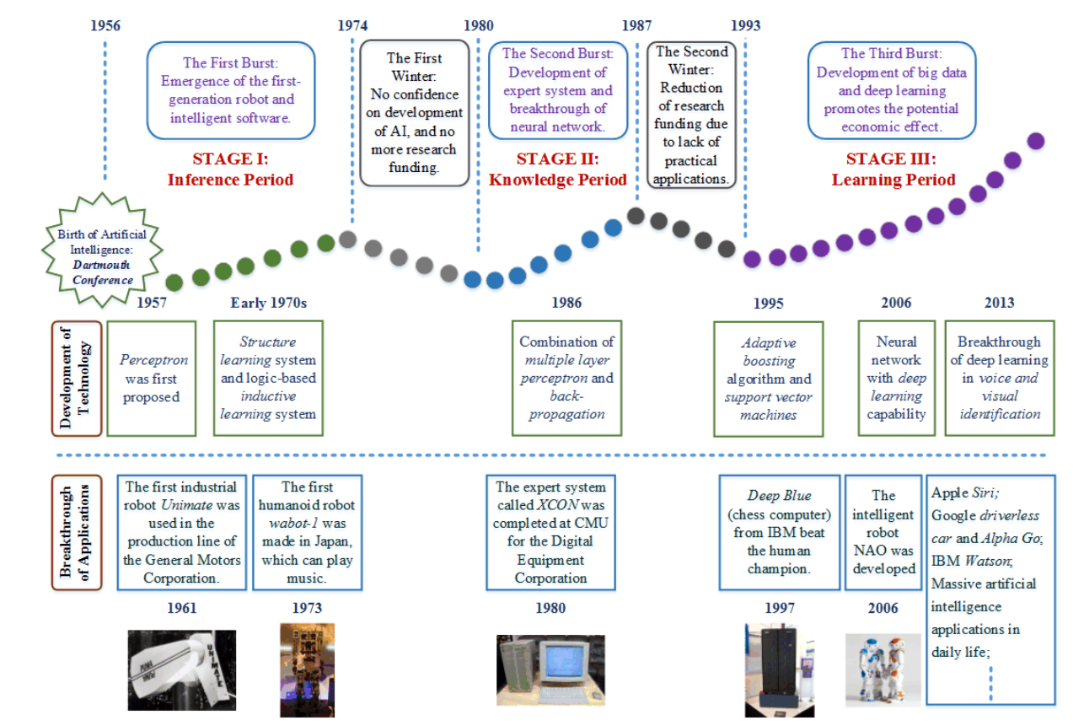
Time

Slide 6
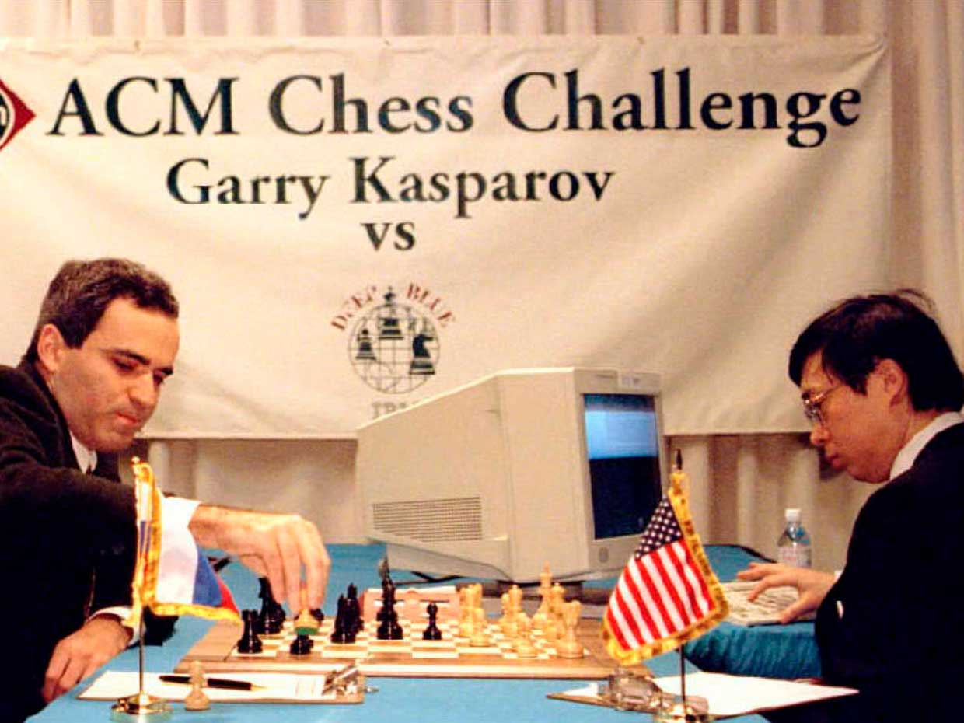

AI milestone: Computer program challenges human brain
First match February 10, 1996, Philadelphia
Kasparov vs. Deep Blue (4-2)
First computer program to defeat a world champion in a classical game under tournament regulations.
Second match (rematch) May 11, 1997, New York
Deep blue vs. Kasparov (3½ - 2½)
First computer program to defeat a world champion in a match under tournament regulations.
The 1997 match was the subject of a documentary film, The Man vs. The Machine.

Slide 7
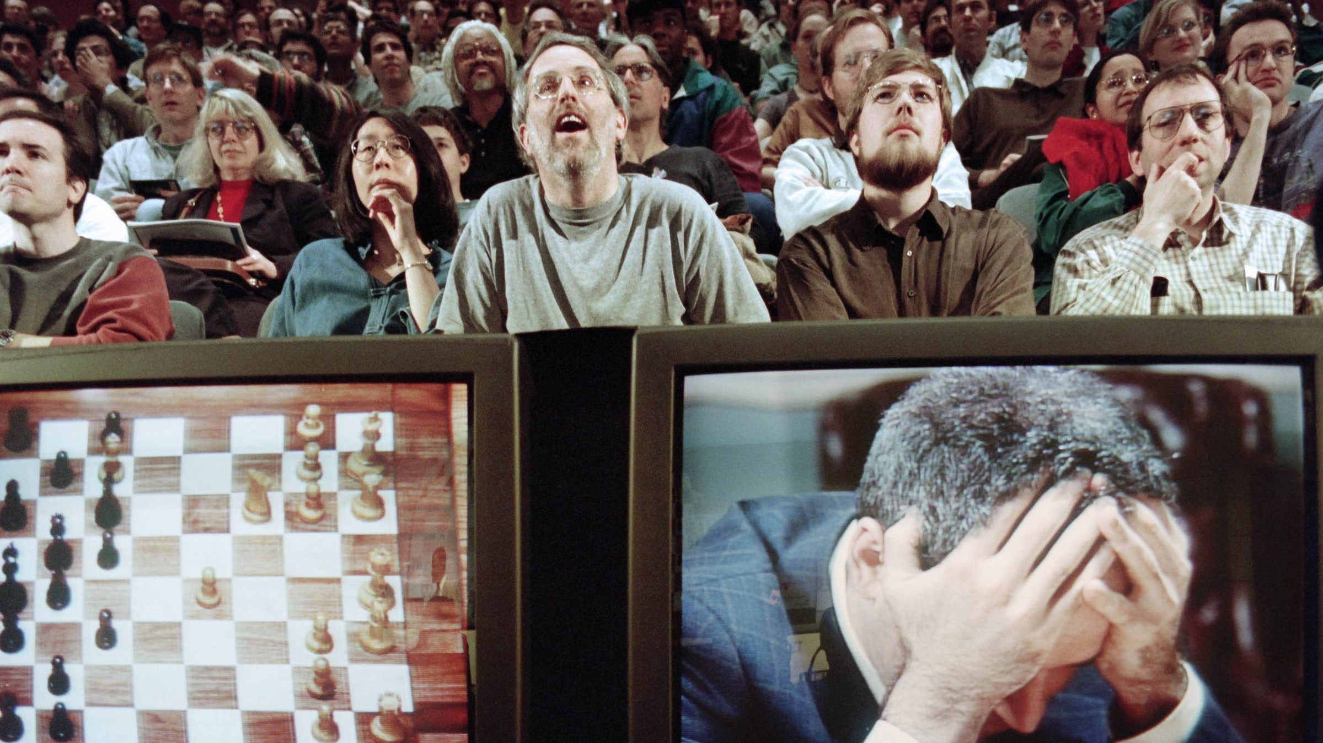
Human vs. Computer
The world was astonished.
But Deep Blue was not the human-like intelligence.
It won by brute force by searching through millions of moves in seconds.

Slide 8
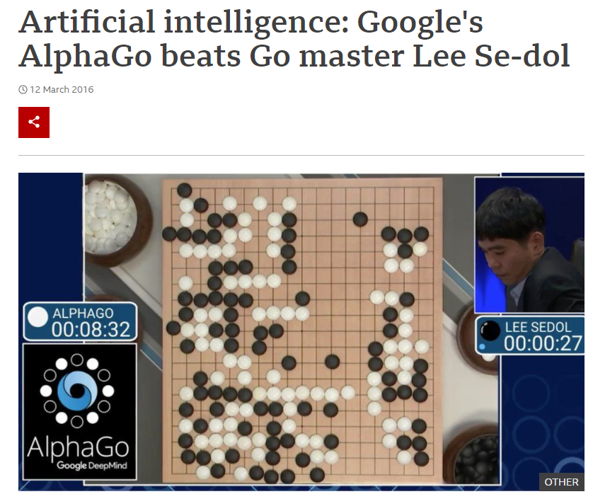
AI milestone: Machine beats Human champion at Go
Mar 12, 2016
AlphaGo has won 4:1 against the 18-time world Go champion Lee Sedol
Much better than the score of Deep Blue
More read: https://www.bbc.com/news/technology-35785875

Slide 9
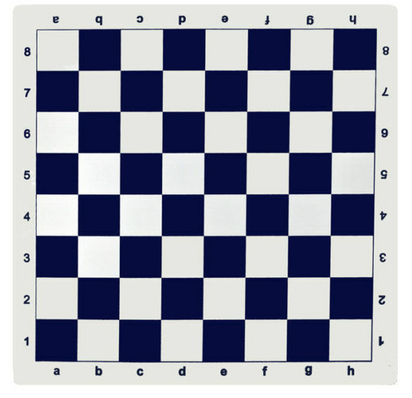
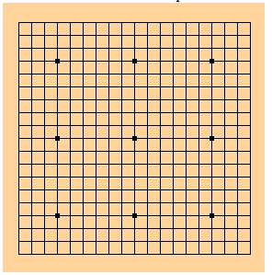
Complexity: Go vs. Chess
The board of Go is 19x19=361 intersections.
Chess has 8x8=64 squares.
The estimated number of possible board configuration is 10¹⁷⁴ in Go.
Chess has 10¹²⁰ configurations
Go has 10⁵⁴ more configurations than Chess.
Million(6)-trillion(12)-trillion(12)-trillion(12)-trillion(12) more
The Earth has roughly7.5 x 10¹⁸ grains of sand

Slide 10
Brute force searching on Go board
OK, easy, let’s take all the possibilities of the first step
361! = 1 437 923 258 884 890 654 832 362 511 499 863 354 754 907 538 644 755 876 127 282 765 299 227 795 534 389 618 856 841 908 003 141 196 071 413 794 434 890 585 968 383 968 233 304 321 607 713 808 837 056 557 879 669 192 486 182 709 780 035 899 021 100 579 450 107 333 050 792 627 771 722 750 412 268 086 775 281 368 850 575 265 418 120 435 021 506 234 663 026 434 426 736 326 270 927 646 433 025 577 722 695 595 343 233 942 204 301 825 548 143 785 112 222 186 834 487 969 871 267 194 205 609 533 306 413 935 710 635 197 200 721 473 378 733 826 980 308 535 104 317 420 365 367 377 988 721 756 551 345 004 129 106 165 050 615 449 626 558 110 282 424 142 840 662 705 458 556 231 015 637 528 928 999 248 573 883 166 476 871 652 120 015 362 189 137 337 137 682 618 614 562 954 409 007 743 375 894 907 714 439 917 299 937 133 680 728 459 000 034 496 420 337 066 440 853 337 001 284 286 412 654 394 495 050 773 954 560 000 000 000 000 000 000 000 000 000 000 000 000 000 000 000 000 000 000 000 000 000 000 000 000
Brute force searching on Go board is very hard, if not impossible.

Slide 11
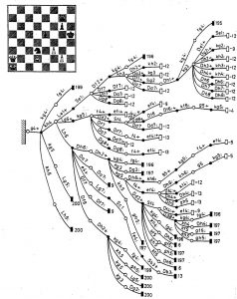
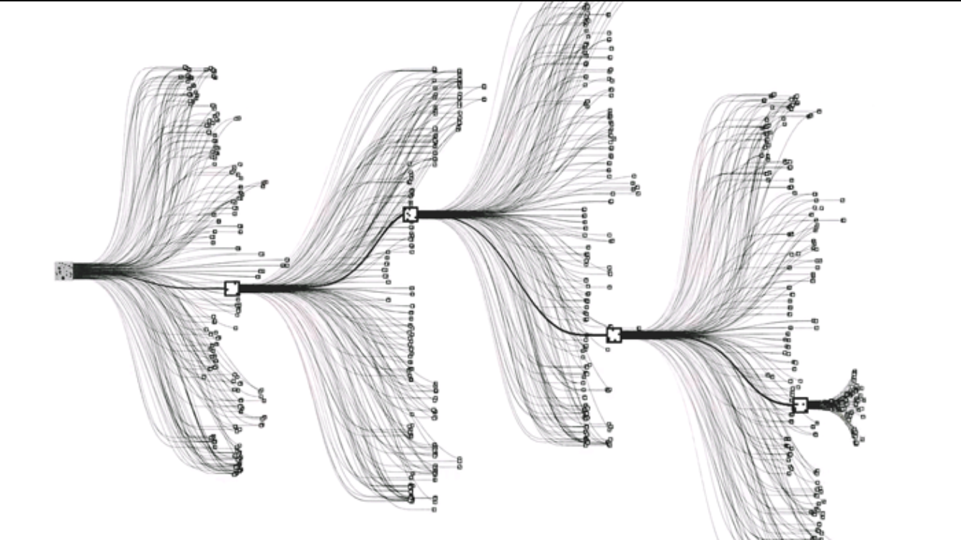
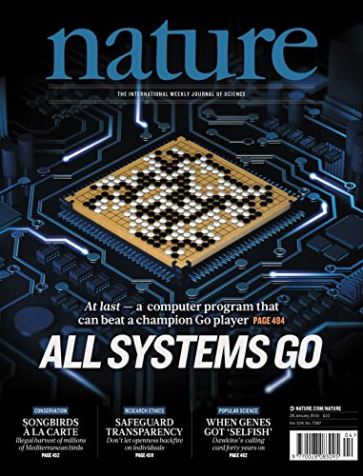
How to make it possible?
Better algorithm (deep neural networks)
Faster hardware (more transistors than 1996, the same power, multi-core)
Smarter SW/HW co-design for higher performance efficiency
Silver, D., Huang, A., Maddison, C. et al. “Mastering the game of Go with deep neural networks and tree search,” Nature 529, 484–489 (2016).

Slide 12

AI milestone: Image classification
Classification probabilities
Pear (0.1)
Bike (0.1)
Car (0.02)
Plane (0.02)
Apple (0.7)
House (0.04)
Machine
Learning
Algorithm
Inferencing
How does it work?

Slide 13
To recognize an apple

Slide 14
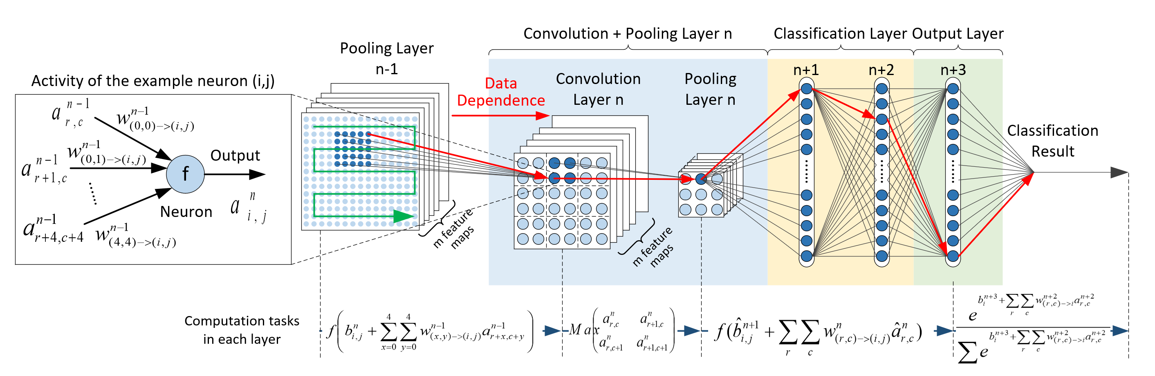
And it seems to be very complicated
Yeah, but how does it really work?

Slide 15
A very simple example to recognize apple

Slide 16

Step 1 Digitalization/segmentation

Slide 17
Step 2 Convolution
Conv. Kernel
1
1
0
1
1
0
1
0
1
Conv.
1
0
1
Pattern 1
1
1
1
1
1
1
1x1+1x1+0x0+1x1+0x0+1x1+1x1+1x1+1x1 = 7
1
0
0
1
1
0
0
0
0
Conv.
1
0
1
Pattern 2
1
0
0
1
1
1
1x1+0x1+0x0+0x1+0x0+0x1+1x1+0x1+0x1 = 2

Slide 18
Step 3 Decision making
1
1
0
1
0
0
1
0
1
0
0
0
1
1
1
1
0
0
Scan through the whole image and count the patterns
The more Pattern 1 are there, the more likely that the image is an apple
Otherwise, it is not so “probably” that it is an apple
If most of the patterns are Pattern 2, then the image can be an orange
The key of successfully recognize an apple lies in the conventional kernel
A good convolution kernel can only be obtained through intensive training.

Slide 19

How to train the ML algorithm is the key
Basic rationale is simple
Let your ML algorithm “sees” as much picture as possible (training)
ImageNet
256x256 pixels
1000 Classes
More than 14 million
Images
1.3M Training
100,000 Testing
50,000 Validation
https://www.image-net.org/

Slide 20
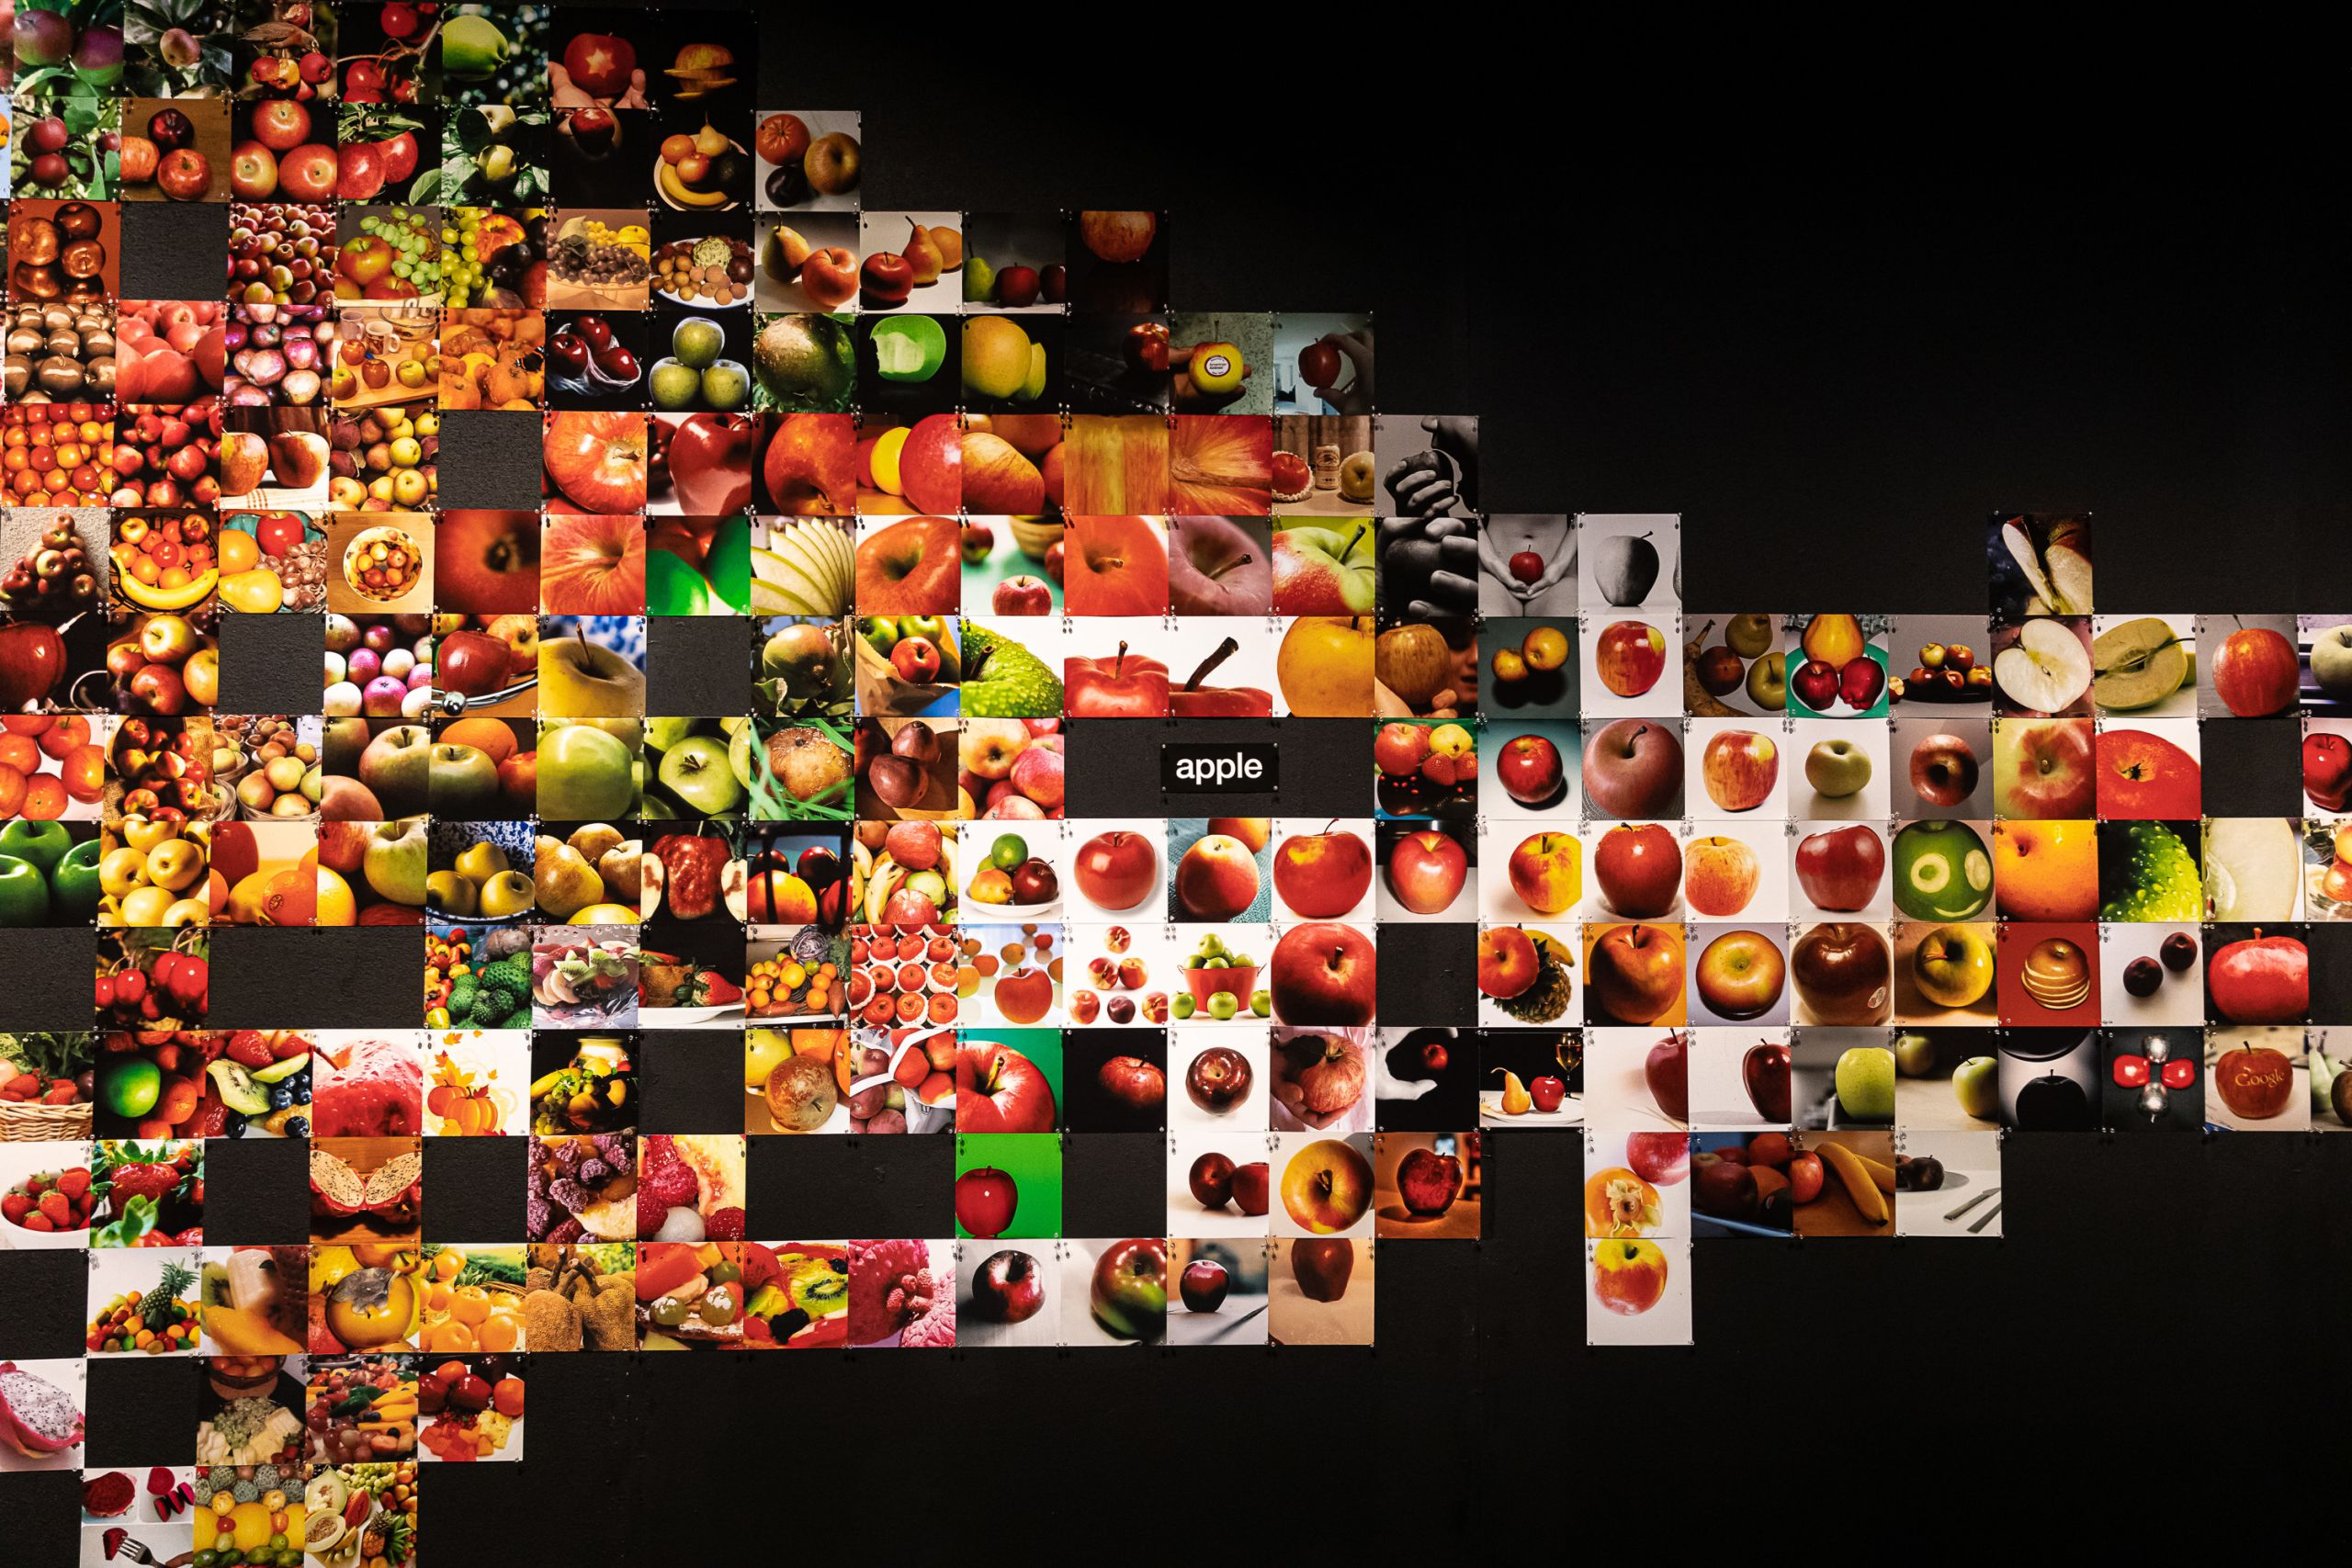
ImageNet
Image for apple
Various kinds
Various backgrounds
Various positions
Various noises
Etc.
All to train robust neural network algorithms

Slide 21
Let’s revisit our neural network
Complicated structure but simple operations.
X, +, linear function
max
X, +, linear function
X, +, division, power

Slide 22
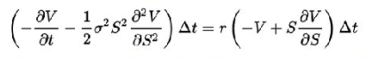
Is NN complicated?
What we have in a NN?
Multiplication, add, max, e to the power of x, linear functions
Compare them with the algorithm in Blackscholes, which is one of the “most simple” HPC benchmark programs
Differential equation
Complex operation

Slide 23
Good things of NN
Unlike general computation tasks, neural networks use a few kinds of simple computations, but in huge amount
This makes NN (or in general term, machine learning algorithms) popular when Dennard scaling has been dead, and Moore’s law is still alive
We cannot increase the frequency of single-cores
We cannot make more general cores for many-cores
But we can use what we have doing specific tasks in smarter ways
Accelerators!
This is the motivation of accelerators

Slide 24
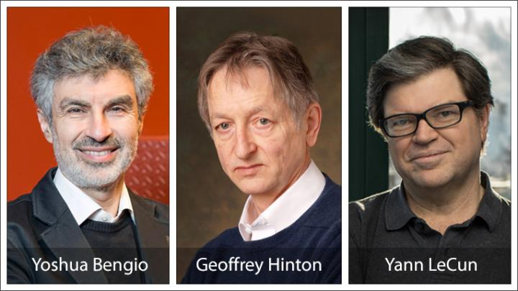
Fathers of the Deep Learning Revolution Receive ACM A.M. Turing Award
Bengio, Hinton and LeCun in Major Breakthroughs in Artificial Intelligence.
For conceptual and engineering breakthroughs that have made deep neural networks a critical component of computing.
https://www.acm.org/media-center/2019/march/turing-award-2018

Slide 25
Where is deep learning algorithm running?
Deep learning algorithms
Micro-processor
(CPU)
Graphics processor
(GPU)
Accelerator
Application
Specific
Instruction
Set
Processor
(ASIP)
Field
Programmable
Gate Array
(FPGA)
Application Specific Integrated Circuit
(ASIC)

Slide 26
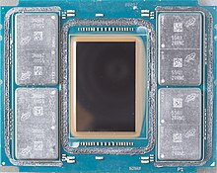
CPU for deep learning
Bad fit for deep learning
Intel Knights Landing (2016, discontinued)
7 TFLOPS FP32
16GB MCDRAM-400 GB/s
245W TDP
29 GFLOPS/W FP32
14nm process
Intel Knights Mill (2017, launched)
Next gen Xeon Phi optimized for deep learning
New vector instruction for deep learning
AVX512-4VNNIW and AVX512-4FMAPS
Why is CPU bad for ML?

Slide 27
Execution of a simple program
High address
(0xFF)
Command-line
arguments
Stack
int a = 1;
int x;
Disk
int main(void) {
CPU
int b, sum;
MMS
b = 2;
sum = a + b;
char* y = malloc(10);
Heap
printf(“%d\n”, sum);
exit(0);
Un-init. Data (bss)
}
Initialized data
Low address
(0x00)
Text (code)
Notes:
Let start with a very simple computer system.
Although it is simple but will serve our purpose well.
The system contains one CPU, a small memory, and a disk.
And by default, our program, or the executable, is stored on the disk.
/* For simplicity concern, we stay with the high-level language, instead of the ELF file
To illustrate how our system works.*/
The first thing to create a process is that we allocate a trunk of memory
To the process being created.
In this example, we allocate the whole memory to a single process.
To create the process, the execution function in linux
Sees the whole memory space of the process as different segments.
Some of the segments are directly copied from the executable file,
While others will be used during the process execution runtime.
The big picture here is that to create a process, our memory
Is segmented in accordance to the segments in the executable, so that
Process can be created based on the corresponding executable.
We also have details on how the program shown here interacts with the
CPU and the memory. But we will put them later.

Slide 28
Execution of a simple program
High address
(0xFF)
Command-line
arguments
Stack
int a = 1;
int x;
Disk
int main(void) {
CPU
int b, sum;
MMS
b = 2;
sum = a + b;
char* y = malloc(10);
Heap
printf(“%d\n”, sum);
exit(0);
Un-init. Data (bss)
x:0
}
Initialized data
Low address
(0x00)
a:1
Text (code)
int main(void) {
PC
Notes:
When a process starts execution, the first
Instruction will always be the main() function.
The instruction will be fetched from the text segment to the cpu
To execute.
All parameters of the main function will be
found within the command-line arguments segments.
But since we have no input parameters, nothing
Really show up here.

Slide 29
Execution of a simple program
High address
(0xFF)
Command-line
arguments
Stack
int a = 1;
b:xx
sum:xx
int x;
Disk
int main(void) {
CPU
int b, sum;
MMS
b = 2;
sum = a + b;
char* y = malloc(10);
Heap
printf(“%d\n”, sum);
exit(0);
Un-init. Data (bss)
x:0
}
Initialized data
Low address
(0x00)
a:1
int b, sum;
Text (code)
PC
Notes:
Our process will be executed in the program order.
So the next instruction will create two variables
Called b and sum, in the memory segment call stack,
which grows from high address to low address,
With new variables always created on the top.
By the way, all uninitialized variables created
In the stack are having random values, denoted by the xx here.

Slide 30
Execution of a simple program
High address
(0xFF)
Command-line
arguments
Stack
int a = 1;
b:2
b:xx
sum:xx
int x;
Disk
int main(void) {
CPU
int b, sum;
MMS
b = 2;
sum = a + b;
char* y = malloc(10);
Heap
printf(“%d\n”, sum);
exit(0);
Un-init. Data (bss)
x:0
}
Initialized data
Low address
(0x00)
a:1
Text (code)
b = 2;
PC
Notes:
The next instruction updates the value of
B in the stack from random number to 2.

Slide 31
Execution of a simple program
High address
(0xFF)
Command-line
arguments
Stack
int a = 1;
b:2
b:xx
sum:3
int x;
sum:xx
Disk
int main(void) {
CPU
int b, sum;
MMS
b = 2;
sum = a + b;
char* y = malloc(10);
Heap
printf(“%d\n”, sum);
exit(0);
Un-init. Data (bss)
x:0
}
Initialized data
Low address
(0x00)
a:1
sum = a + b;
Text (code)
PC
Notes:
And in the next instruction, we read the values of
A and b from the initialized data segment and the
Stack correspondingly to the CPU.
The CPU adds them up, and update the results in the stack
To 3.

Slide 32
Execution of a simple program
High address
(0xFF)
Command-line
arguments
Stack
int a = 1;
b:2
b:xx
sum:3
int x;
sum:xx
Disk
y:0x3F
int main(void) {
CPU
y:xx
int b, sum;
malloc
MMS
b = 2;
sum = a + b;
10
char* y = malloc(10);
Heap
10 bytes
printf(“%d\n”, sum);
exit(0);
Un-init. Data (bss)
x:0
}
Initialized data
Low address
(0x00)
a:1
char* y = malloc(10);
Text (code)
PC

Slide 33
Execution of a simple program
High address
(0xFF)
Command-line
arguments
Stack
int a = 1;
b:2
b:xx
sum:3
int x;
sum:xx
Disk
int main(void) {
API and ABI are for general purpose computing.
CPU
y:0x3F
int b, sum;
MMS
printf
b = 2;
sum = a + b;
char* y = malloc(10);
Heap
10 bytes
printf(“%d\n”, sum);
y:0x3F
y:xx
exit(0);
Un-init. Data (bss)
x:0
}
Initialized data
Low address
(0x00)
a:1
printf(“%d\n”, sum);
Text (code)
PC

Slide 34
GPU for deep learning
Nvidia PASCAL GP100 (2016)
10/20 TFLOPS FP32/FP16
16GB HBM – 750 GB/s
300W TDP
16nm process
15.3B Transistors
Die size: 610 mm²
Nvidia Volta GV100 (2017)
15 FP32 TFLOPS
16GB HBM2 – 900 GB/s
300W TDP
12nm process
21B Transistors
Die size: 815 mm²
8 new Tensor cores, providing 120 Tensor TFLOPS

Slide 35
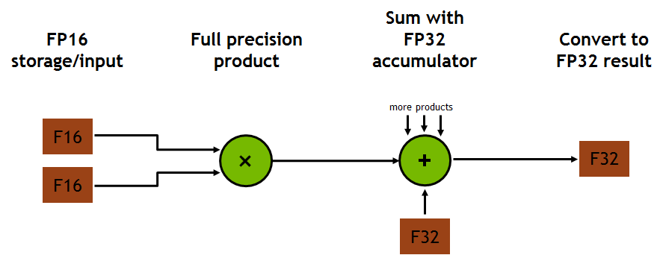
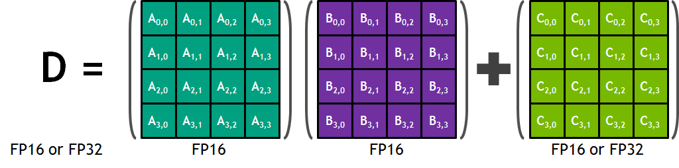
New in Volta: Tensor core
Also available in later microarchitecture Turing, Ampere
A new instruction that performs 4x4x4 mixed-precision operations per clock
12X increase throughput compared to Pascal
https://developer.nvidia.com/blog/inside-volta/
Way better than CPU. But is that all?

Slide 36
Executing the simple program using GPU
__global__ void add(int *a, int *b, int *sum)
{
*sum = *a + *b;
}
int main(void) {
int a, b, sum; // host copies of a, b, sum
int *d_a, *d_b, *d_sum; // device copies of a, b, sum
int size = sizeof(int);
// Allocate space for device copies of a, b, sum
cudaMalloc((void **)&d_a, size);
cudaMalloc((void **)&d_b, size);
cudaMalloc((void **)&d_sum, size);
// Setup input values
a = 1;
b = 2;
// Addition on the Device: main()
// Copy inputs to device
cudaMemcpy(d_a, &a, size, cudaMemcpyHostToDevice);
cudaMemcpy(d_b, &b, size, cudaMemcpyHostToDevice);
// Launch add() kernel on GPU
add<<<1,1>>>(d_a, d_b, d_sum);
// Copy result back to host
cudaMemcpy(&sum, d_sum, size, cudaMemcpyDeviceToHost);
// Cleanup
cudaFree(d_a); cudaFree(d_b); cudaFree(d_sum);
printf("%sum",&sum);
return 0;
}
Powerful for vector processing.

Slide 37
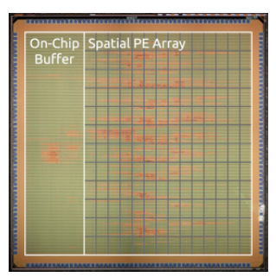
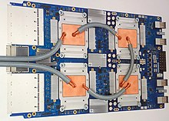
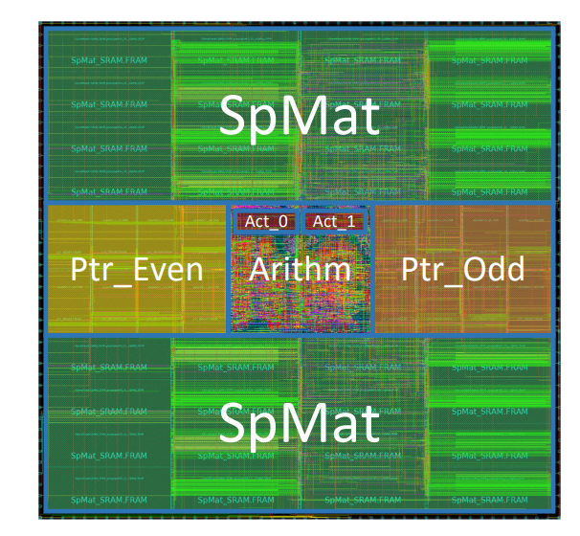
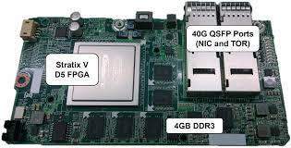
Accelerators (ASICs, FPGAs, etc)
Why accelerators are better than GPUs?
Lower bit width, lower memory access, shorter data/computation distance, fewer data movement, increased data reuse, etc.
MIT Eyeriss
CNN
2016
Google TPU
Matrix Multi.
2016
Stanford EIE
Compressed NN
2016
Microsoft Catapult
Search engine ranking
2016

Slide 38
Executing the simple program using an accelerator
Reg
(b)
Local
Memory
(eDRAM,
Scratchpad,
etc)
int a = 1;
int x;
Disk
int main(void) {
We trade generality with speed.
Adder
(+)
int b, sum;
b = 2;
Reg
(a)
sum = a + b;
char* y = malloc(10);
printf(“%d\n”, sum);
exit(0);
}
CLK

Slide 39

Questions?

